Slide 1
Review of Prescribed Minimum Benefits
Inaugural Health Funders Consultative Forum
28 March 2017
Health Funders Association Boardroom, Woodmead
Boshoff Steenekamp, MMI Health

Slide 2
Content
Challenges with the PMB package
Policy uncertainty – potential interventions towards Universal Health Coverage
Proposed PMB review Process
Formal priority setting process
Iterative, transparent, participative – this reform requires broad acceptance by all participants
Elaborate, complex, technically difficult – high risk of failure
Sustainability interventions
Proposed package
Conclusion

Slide 3
Challenges with PMB Package

Slide 4
Incidence trend for PMB- and non-PMB mood disorder claims
Adapted from: Raath, Christoff. Prescribed Minimum Benefits Impact Analysis. Presentation to the Department of Health. s.l. : Insight Actuaries, 12 November 2014.

Slide 5
Specialist cost per life index (Real terms)
Adapted from: Raath, Christoff. Prescribed Minimum Benefits Impact Analysis. Presentation to the Department of Health. s.l. : Insight Actuaries, 12 November 2014.

Slide 6
Contributing factors to PMB challenges
Tariff determination, fee-for-service remuneration
Unclear definition of benefit
No incentives to maintain and improve health
Hospicentric – no primary care
Fee-for-service remuneration
No coordinated and comprehensive approach to priority setting

Slide 7
Policy uncertainty
Potential interventions towards Universal Health Coverage

Slide 8
Health policy developments
Taylor committee report (2002)
Introduction of REF halted (2008)
Green paper on National Health Insurance (2011). Advisory committee established, report not in public domain
Draft White Paper on NHI (2015)
Reports of task teams not in public domain

Slide 9
Health system challenges
Functions
Intermediate
objectives
Coverage
goals
Creating resources
Equity in resource distribution
Utilisation in relation to need
Financing
Revenue collection
Stewardship, governance, oversight
Pooling
Benefits
Efficiency
Financial protection and equity in finance
Purchasing
Transparency and accountability
Quality
Service delivery
Steenekamp, Boshoff. Review of South African healthcare financing: towards Universal Health Coverage. A contribution towards the debate on achieving Universal Health Coverage in South Africa. Centurion, South Africa : MMI Health, 15 July 2016.
McIntyre, Diane and Kutzin, Joseph. Health financing country diagnostic: a foundation for national strategy development. Health Systems Governance & Finance. Geneva : World Health Organization, 2016. ISBN 978 92 4 151011 0.

Slide 10
A health financing strategy should define…
…changes to revenue raising, purchasing, benefit design, and overall system architecture and governance…
…to address specific, identified problems that limit progress towards UHC (final and intermediate) objectives…
… and provide a solid foundation for future development of a system…
…that can be feasibly implemented given current and expected future contextual constraints.
Joe Kutzin, Study material, WHO advanced course on health financing for universal health coverage for low and middle income countries.

Slide 11
Interventions towards UHC
Service delivery, creating resources, stewardship, governance and oversight
Revenue collection
Pooling
Purchasing
Benefits
Single health information platform
Virtual single risk pool
Risk adjustment mechanism for medical schemes
Norms and standards for equitable financing in provinces
Priority setting authority (NICE or HITAP)
Coding, remuneration, and outcomes authority
Transversal contracts for medicines, surgicals, labs and equipment
Prepare for a purchaser provider split, improve service delivery
State sponsorship for missing middle
Stewardship, governance and oversight
Creating resources
Revenue collection
Single health information platform
Based on: MMI Health. MMI Comments on NHI White Paper. Pretoria : MMI Holdings, 31 May 2016.

Slide 12
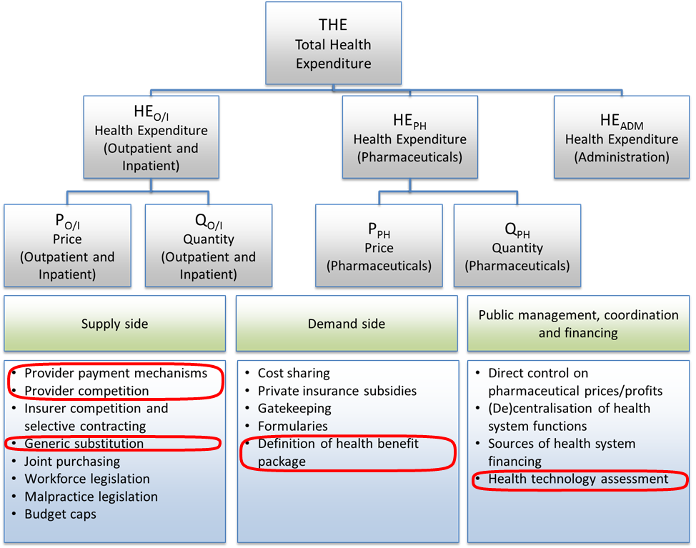
Potential cost-containing policy interventions achievable through the PMB review
Based on: Moreno-Serra, Rodrigo. The impact of cost-containment policies on health expenditure. [book auth.] OECD. Fiscal Sustainability of Health Systems. Bridging Health and Finance Perspectives. Paris : OECD Publishing, 2015.

Slide 13
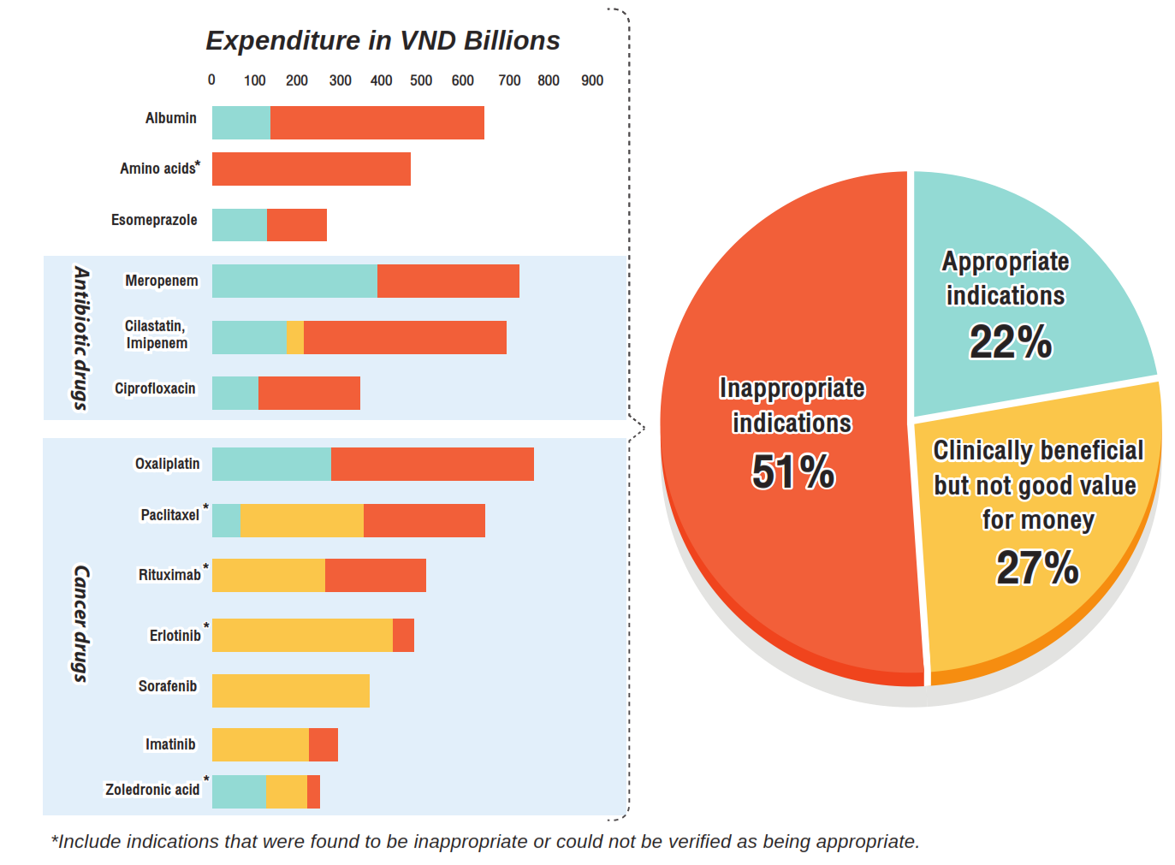
Impact of unqualified access to medicines
Thiboonboon, Kittiphong, et al., et al. f1000research.com. Policy Brief: Reaching the low-hanging fruits of Vietnam’s Health Benefit Package reform [version 1; not peer reviewed]. [Online] March 1, 2017. https://f1000research.com/documents/6-203.

Slide 14
Proposed PMB review process

Slide 15
Sequencing of the process
Provide clarity on policy objectives
Consider approaches to identify priority interventions that must be included in the package
Define the package based on an agreed upon prioritisation mechanism
Develop clinical guidelines inclusive of algorithms for chronic disease management, screening for public health priorities and diagnostic guidelines
Cost the revised PMB package
Estimate the affordability level

Slide 16
Proposed governance structure
PMB review Steering Committee
Project Manager
Clinical stream
Actuarial and Economic stream
Costing team
Affordability assessment team
Multiple clinical advisory committees
Representative advisory body
Legal stream

Slide 17
Proposed prioritisation process

Slide 18
Identify priority services
Service | Weight
1) Maternity & new born care | 100
2) Primary prevention and secondary prevention | 95
3) Chronic disease management | 75
4) Reproductive services | 70
5) Comfort care | 65
6) Fatal conditions, where treatment is aimed at disease modification or cure | 40
7) Nonfatal conditions, where treatment is aimed at disease modification or cure | 20
8) Self-limiting conditions | 5
9) Inconsequential care | 1
Oregon Health Services Commission. Prioritization of Health Services. A Report to the Governor and the 74th Oregon Legislative Assembly. Oregon.gov. [Online] 2007. [Cited: 5 February 2017.] https://www.oregon.gov/oha/herc/Documents/2007-09%20Biennial%20Report%20to%20Governor%20and%20Legislature,%20June%202007.pdf.

Slide 19
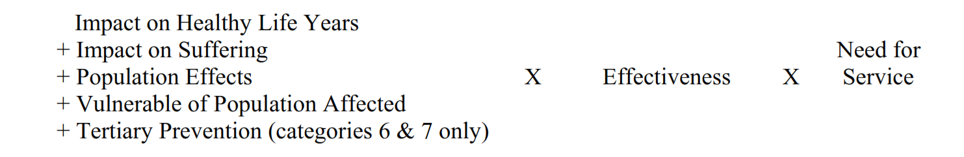
Consider impact on health and social security
Oregon Health Services Commission. Prioritization of Health Services. A Report to the Governor and the 74th Oregon Legislative Assembly. Oregon.gov. [Online] 2007. [Cited: 5 February 2017.] https://www.oregon.gov/oha/herc/Documents/2007-09%20Biennial%20Report%20to%20Governor%20and%20Legislature,%20June%202007.pdf.

Slide 20
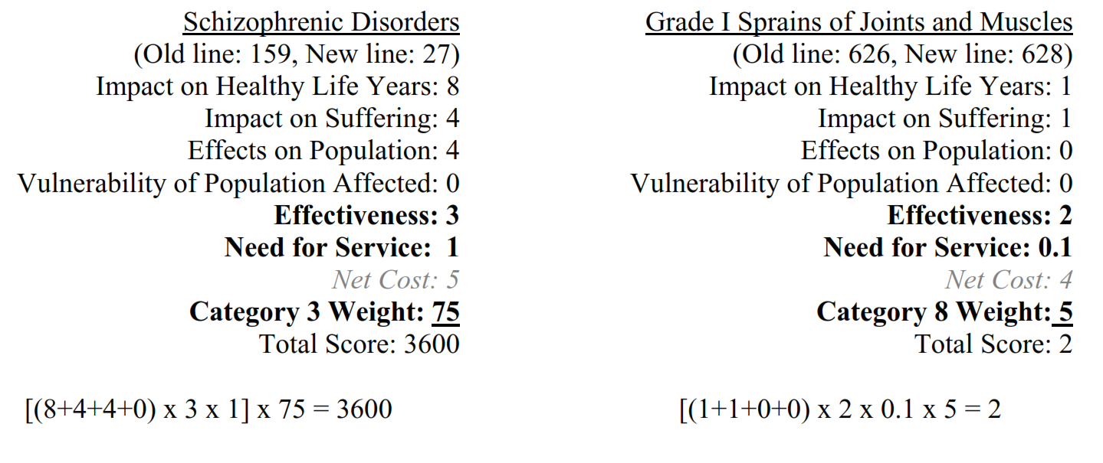
Example of outcome of the prioritisation process
Oregon Health Services Commission. Prioritization of Health Services. A Report to the Governor and the 74th Oregon Legislative Assembly. Oregon.gov. [Online] 2007. [Cited: 5 February 2017.] https://www.oregon.gov/oha/herc/Documents/2007-09%20Biennial%20Report%20to%20Governor%20and%20Legislature,%20June%202007.pdf.

Slide 21
Examine impact on affordability
The nature and of scope the package significantly influenced by sustainability measures
Use Living Conditions Survey data: Estimate affordability to households and impact on membership numbers
Use model to determine final scope of the Low Cost Benefit Options
Living Conditions of Households in South Africa.An analysis of household expenditure and income data using the LCS 2014/2015. Statistics South Africa. Pretoria : Statistics South Africa, 27 January 2017. Statistical release P0310.

Slide 22
Proposed sustainability interventions

Slide 23
Sustainability measures for consideration
Create primary care teams
Employment of health professionals by hospitals
Tariff determination and reimbursement mechanisms
Availability of vaccines, medicines, disposables and laboratory services at state tender prices
Clinical coding systems and groupers
Incentives to focus on improved health
Protection of risk pools

Slide 24
Proposed PMB package

Slide 25
Package design
Out of hospital
In hospital
Specialist care
1) Maternity & new born care
2) Primary prevention and secondary prevention
3) Chronic disease management
4) Reproductive services
5) Comfort care
6) Fatal conditions, where treatment is aimed at disease modification or cure
7) Nonfatal conditions, where treatment is aimed at disease modification or cure
8) Self-limiting conditions
9) Inconsequential care
Supplementary
package
Comprehensive package
High cost, unpredictable,
low frequency events
Protect risk pools
Financial protection for catastrophic events
Basic NHI
package
NHI basic package
Low cost benefit options
Address public health priorities
Low cost, high frequency,
predictable events

Slide 26
Legal considerations

Slide 27
Ensure strict adherence to all relevant legislation
Consultation is critical
Wider than the Minister, CMS and industry stakeholders.
Must involve the provinces and members of the public.
Ebersohn judgement which set aside the RPL regulations provides guidance on the depth of consultation required

Slide 28
Conclusion

Slide 29
Conclusion
The proposed PMB review process is very complex and will require a lot of effort by many stakeholders. Because PMBs have a large impact on many stakeholders, it is important that the process is participative, transparent and legally sound.

Slide 30

Lluis Masriera. Sombras reflejadas (1920)

